Slide 1

Bible NLP
Santiago Lampon, Brandon O’Linn

Slide 2
Introduction
The Bible and other religious texts are some of the oldest and most read pieces of literature in the world. In this analysis we will analyze both the Old and New Testaments of the Bible. Some of the analysis that will be done includes, each verse of the bible being analyzed for the most common unigrams, bigrams, and trigrams. Naïve Bayes will be used to classify each verse into genres. Sentiment analysis will also be done on each book to try and capture whether the mood or tone of each is positive negative or neutral.

Slide 3
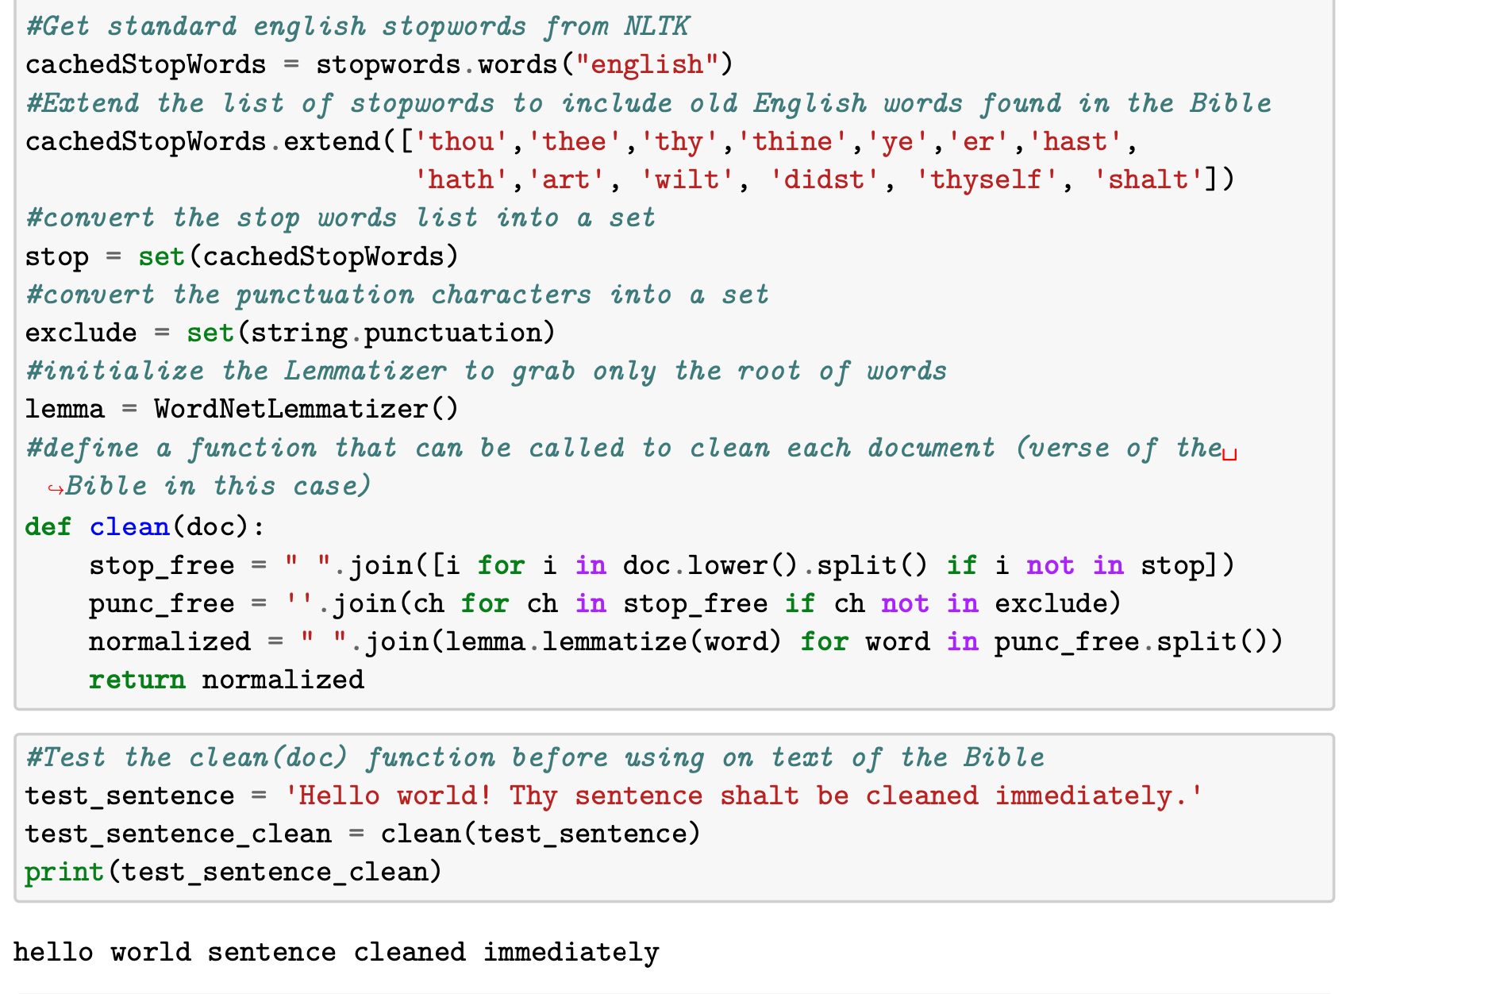
Data Cleaning
Data used came from Kaggle, https://www.kaggle.com/datasets/oswinrh/bible
Loaded the American Standard Version from the Kaggle Bible Corpus, alongside the genre key table.
For this project, we brought the tables in Pandas Data Frame.
We used TextBlob to get the sentiment polarity for each book of the Bible.

Slide 4
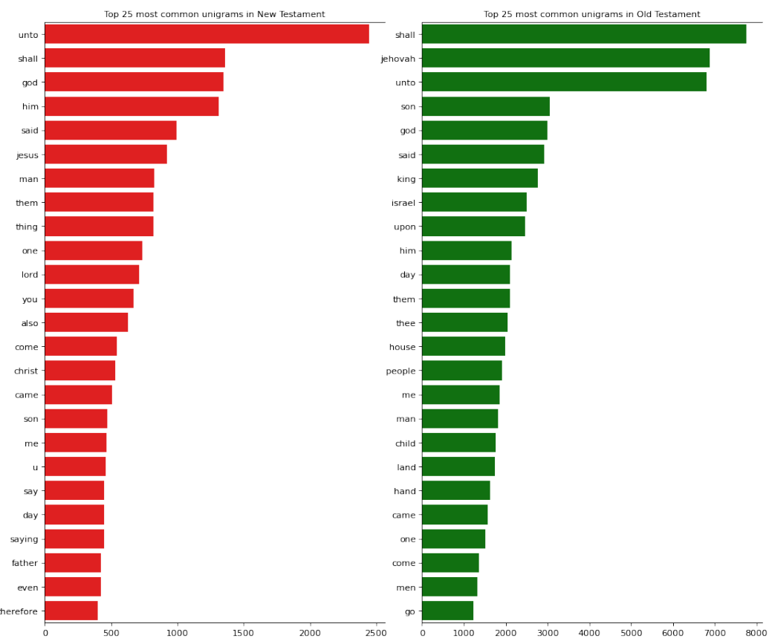
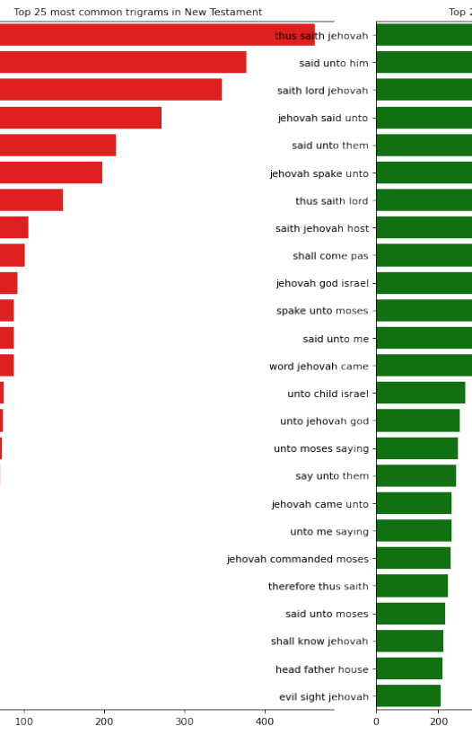
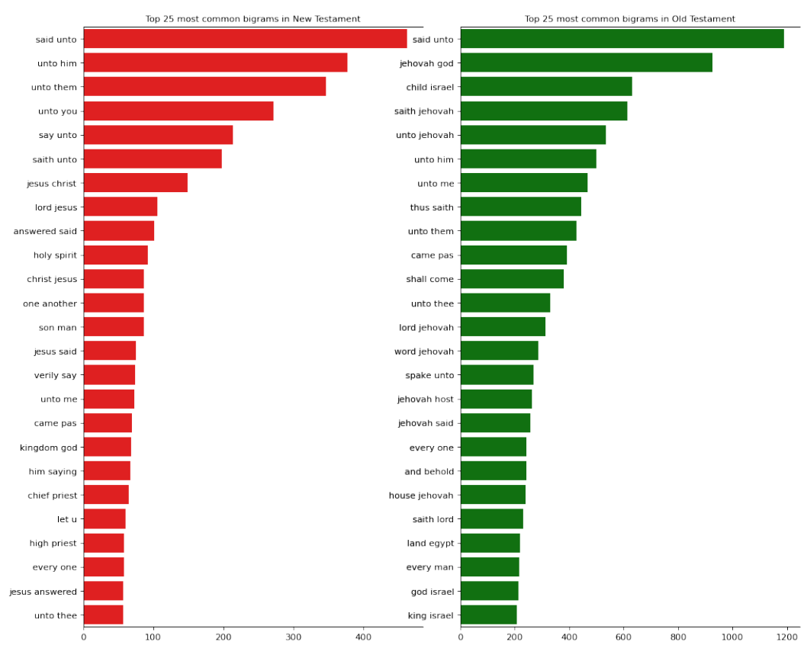
Unigrams, Bigrams and Trigrams
Top 25 unigrams, bigrams and trigrams between the Old and New Testaments
The unigrams shows how prevalent words like King, Israel, and Moses are in the Old Testament versus the recurring words from the New Testament which you see Jesus, God, and Lord.
'jesus' is big in New Testament, together with 'Chirst'. First word is used mostly in Gospels, second one in 'Letters of Apostoles'

Slide 5
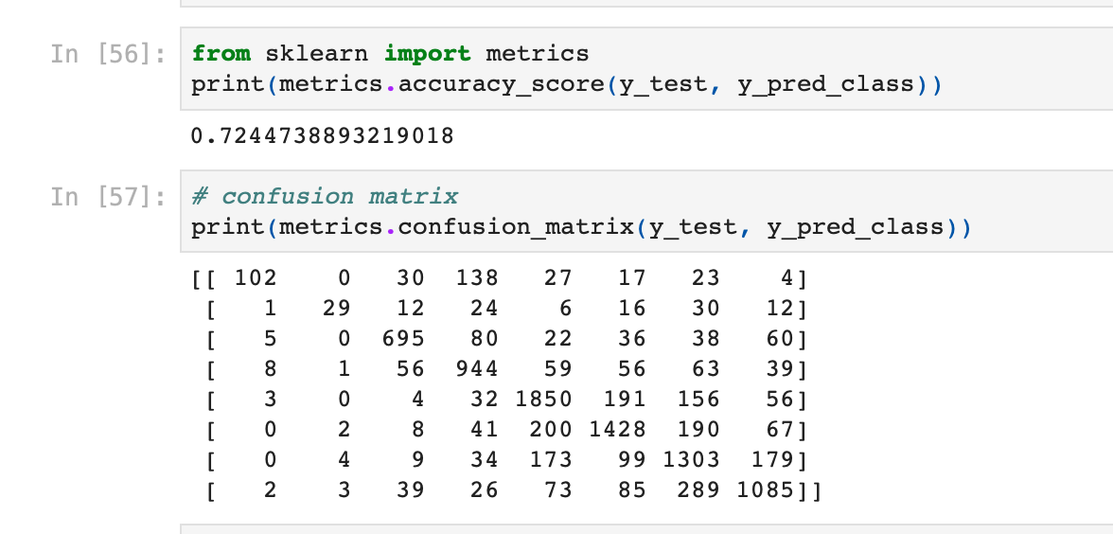
Naïve bayes
Naive Bayes classifier assumes that the presence of a particular feature in a class is unrelated to the presence of any other feature.
Genres for the books in the Bible are Apocalyptic, Acts, Epistles, Gospels, Wisdom, Prophets, Law, and History.
The accuracy score for this model is 72%.

Slide 6
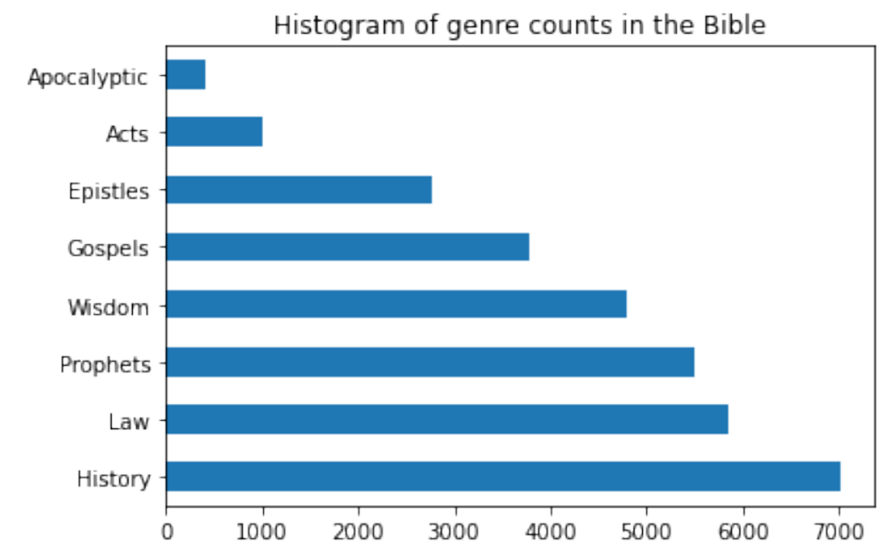
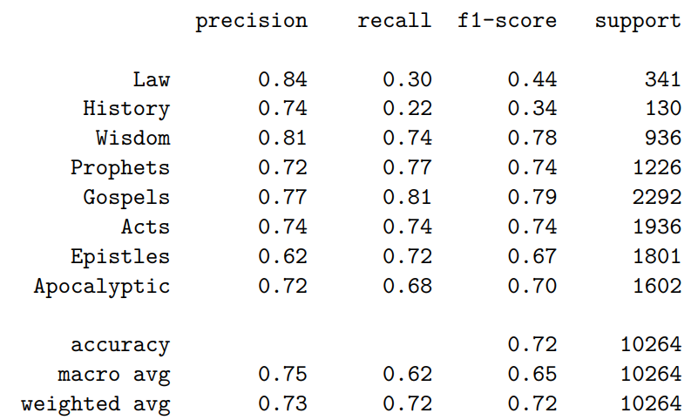
Naïve bayes cont.

Slide 7
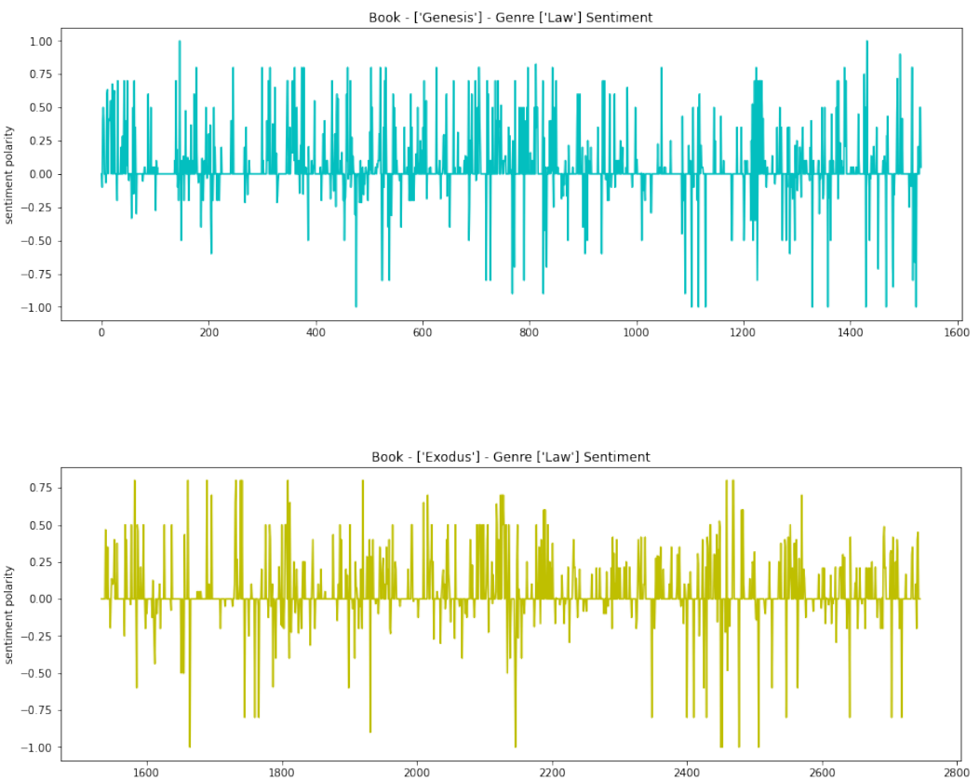
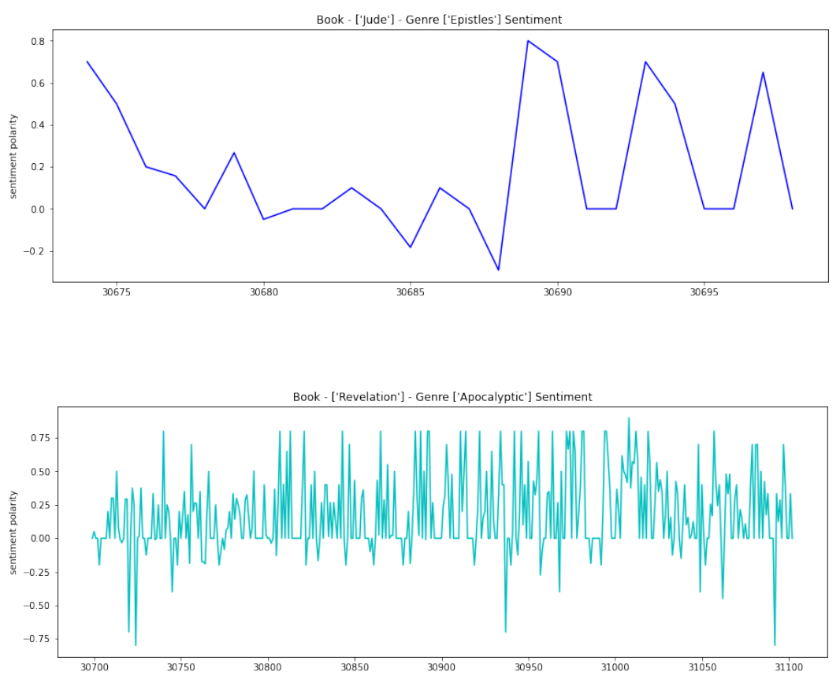
Sentiment Analysis

Slide 8
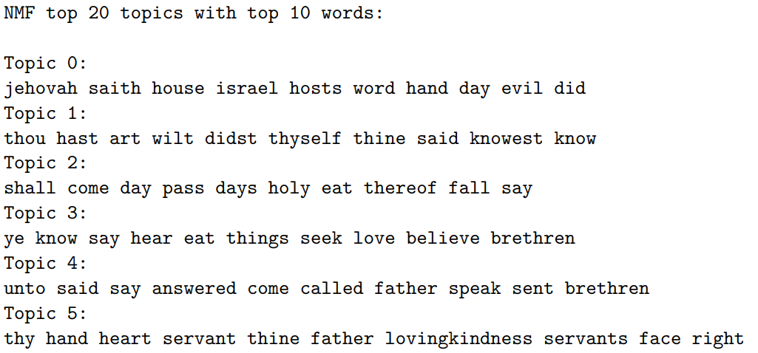
NMF (Non-Negative Matrix FactoRization)

Slide 9
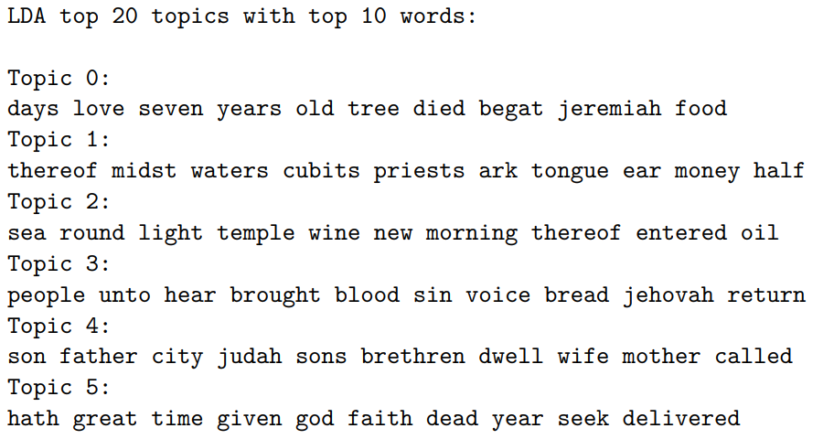
LDA (Latent Dirichlet Allocation)

Slide 10
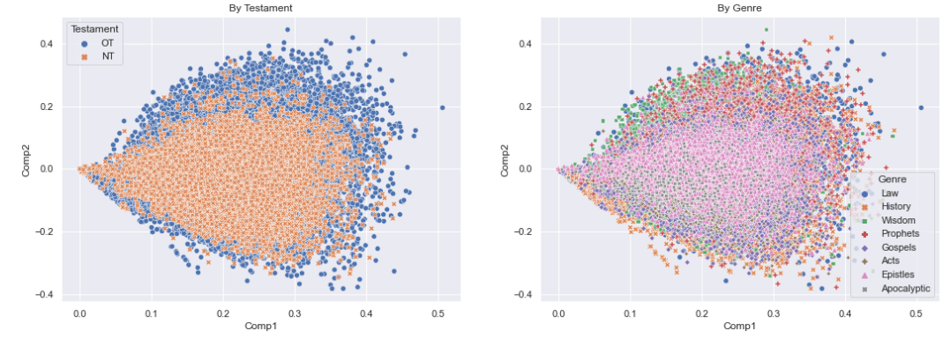
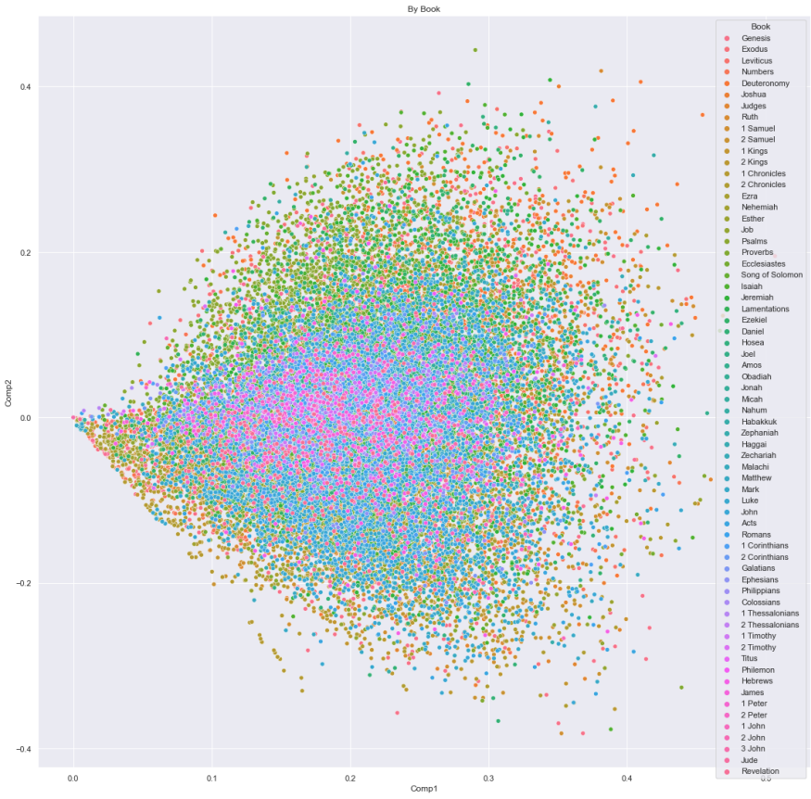
SVD (Singular Value Decomposition basics)

